Slide 1

Movie data analysis
INSAID | EDA Project | Venkat.Mohan

Slide 2
Initial Analysis
By looking at the data, we were able to conclude the below:
Selected movies are released between 2006 and 2016
Running time of movies are as short as 1 hour to as long as 3 hours
Rating range of movies are from 1.9 (lowest rating) to 9.0 (highest rating)
Revenue of the movies range from 13 mn to 900 mn. Considering the release years of movies, there is no much debate on adjustment of inflation

Slide 3
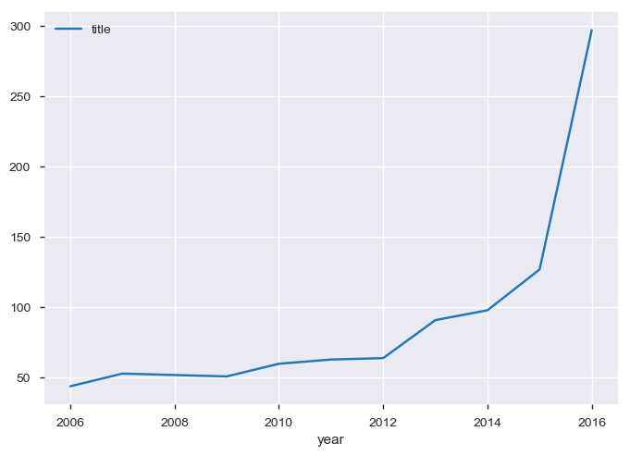
Year-wise movies
Release year of movies range from 2006 to 2016
But we see a skew at 2016, indicating most of the movies (almost 300) are selected from the year 2016

Slide 4
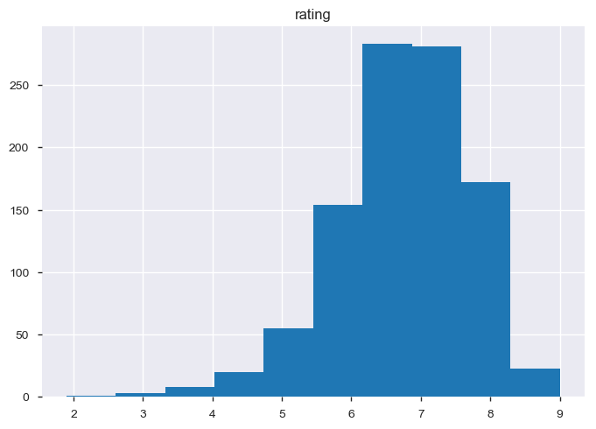
Movies & Ratings
We may see that almost 80% of the movies are distributed across a rating range of 5 to 8

Slide 5
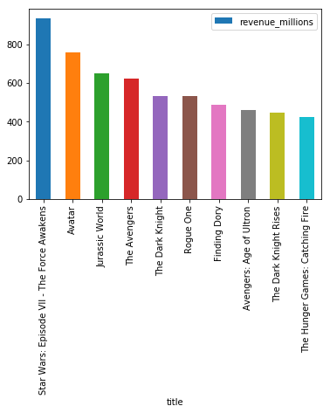
Movies & Gross revenue
Top 10 movies by total amount grossed
Star wars VII (2015) is the top grossing movie

Slide 6
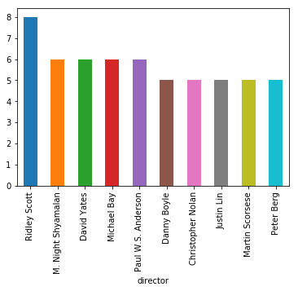
Movies & Directors
Top 10 directors based on number of movies contributed – in this particular dataset
Ridley Scott leads with 8, followed by Indian director Manoj N.Shyamalan with 6

Slide 7
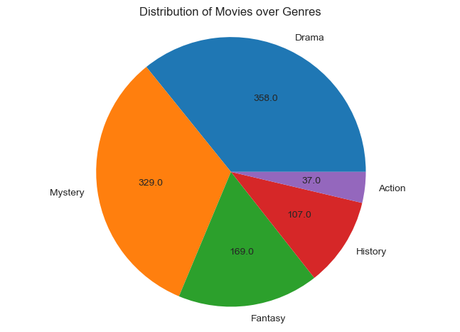
Movies & Genre
Movies are grouped into 5 broad genres and no. of movies across each genre is given
Movies classified as Drama tops followed by Mystery and Fantasy

Slide 8
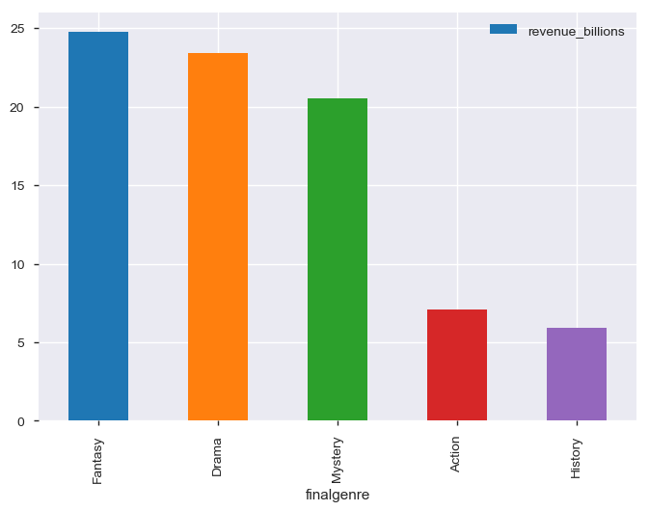
Genre & Collection
Collections based on genre is provided
Though a lot of drama movies were released, collection-wise fantasy movies topped which includes Animation & Sci-fi etc.

